Slide 1
Data Curation Project
Presented By: Group 22
Sai teja reddy Kotha : A20547859
Nallamaddi Nachiketh : A20549679
Madhusudhan Reddy Kappeta : A20548139

Slide 2
What is the Dataset?
Crime Data from 2021 to present.
This dataset reflects incidents of crime in the City of Los Angeles dating back to 2021.
Ex: the crime details, weapon used, suspect details.

Slide 3
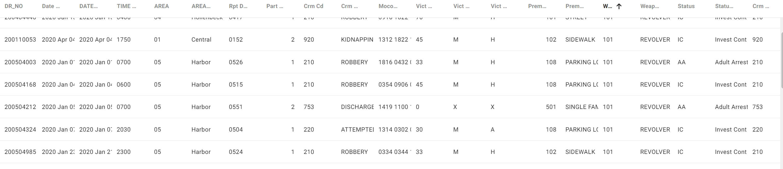
Dataset Overview
416182 Rows, 28 Columns, Each row indicates a crime incident.

Slide 4
Data Quality Problems & Solutions
A) Columns are renamed to make it more description.
Ex: LON, TIME_OCC, Crm_Cd, LAT, Premis_Cd, Premis_Cd

Slide 5
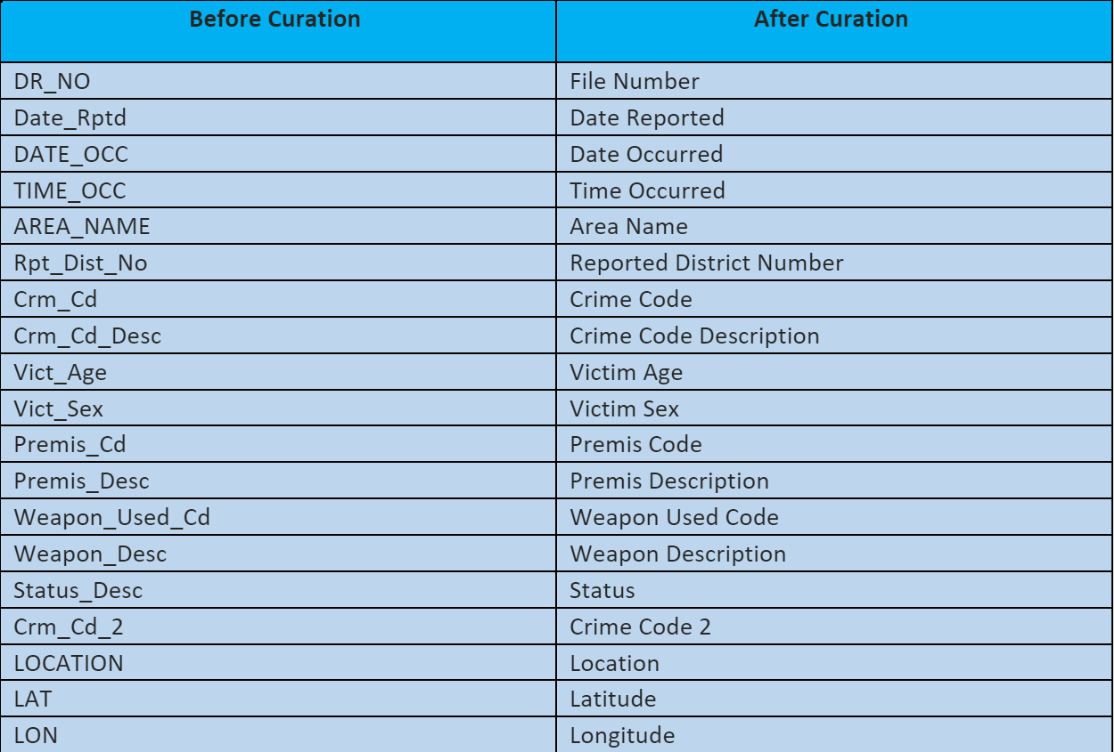
Data Quality Problems & Solutions
Solution:

Slide 6
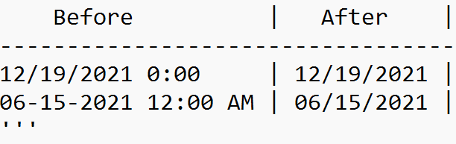
Data Quality Problems & Solutions
B) date columns are not properly formated and consistant across the dataset.
Solution:
1) Standardize the Date Reported column date format to mm/dd/yyyy format.
2) Standardize the Date Occurred column date format to mm/dd/yyyy format.

Slide 7
Data Quality Problems & Solutions
C) Fixing Column Datatypes
Solution:
Column Name | Before Curation Datatype | After Curation Datatype
Date Reported | String | DataTime
Date Occurred | String | DataTime
Reported District Number | Short | Int

Slide 8
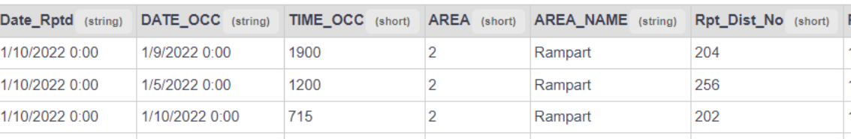
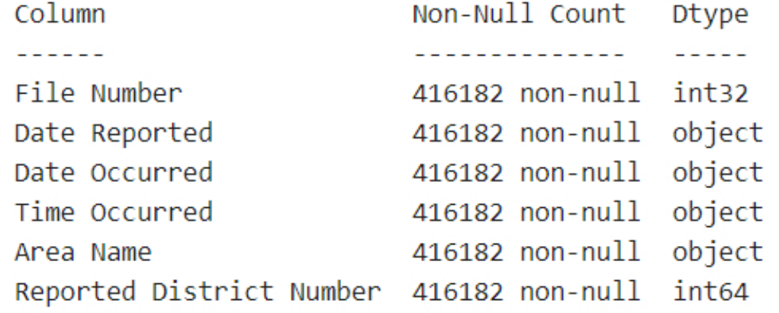
Data Quality Problems & Solutions
Solution:
Before Curation: After Curation:

Slide 9
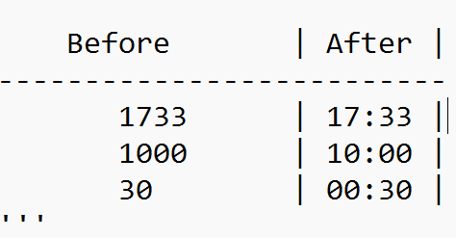
Data Quality Problems & Solutions
D) Convert time in "Time occurred" column from military format to hh:mm format.
Solution:

Slide 10
Data Quality Problems & Solutions
E) Multiple column can be removed which are redundant and not useful.
Solution: Removing columns that are redundant and not useful.
Part 1_2 : since there is no particular use from the data and no column description available in the source.
Area : Since Area name provides the complete details of the area
Status: Status is short form representation of status description column we will be removing the status column and rename the status Desc to Status.
Crm cd1 : contains redundant data i.e., same as Crm cd
Crm cd 3, Crm Cd 4: since they don't have any data.

Slide 11
Data Quality Problems & Solutions
F) Presence of non-null values in "Cross Street" implies rounded addresses in the "Location" column.
Solution:
Utilize latitude and longitude columns to enhance address accuracy.
Replace "Location" values only for records with non-null "Cross Street."
Remove Cross street column since it is no more required.

Slide 12
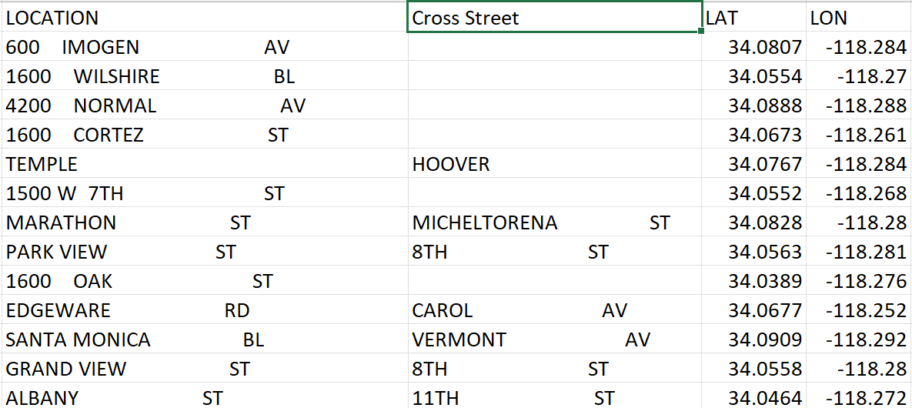
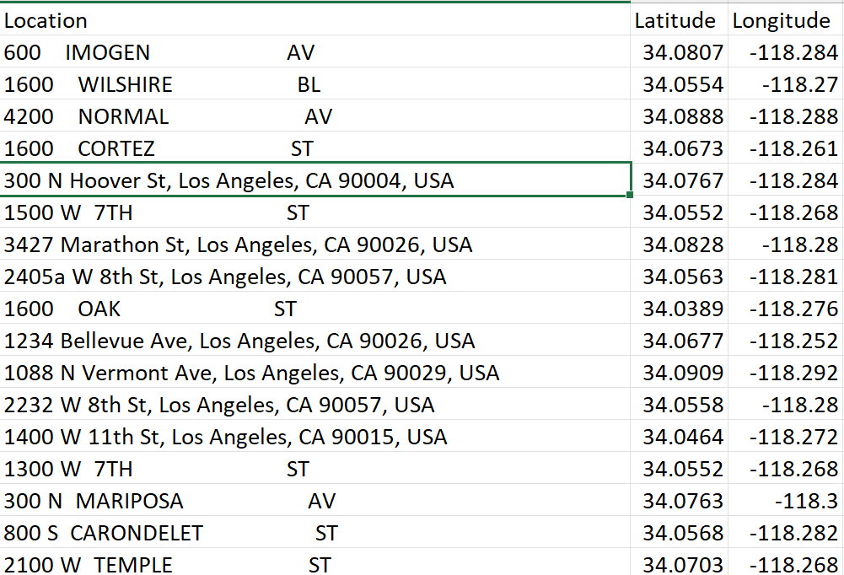
Data Quality Problems & Solutions
Solution:
Before Curation: After Curation:

Slide 13
Challenges Faced:
Challenge: Large Dataset and Platform Constraints
Data Size Dilemma:
Original dataset: >200 MB, 844k records.
Vizier platform limit: 100 MB.
Strategic Data Restriction:
Solution: Restrict data by date.
Utilized Google Maps subscription API for "Location" column reverse geocoding. Overcame daily limitations, ensuring efficiency.

Slide 14
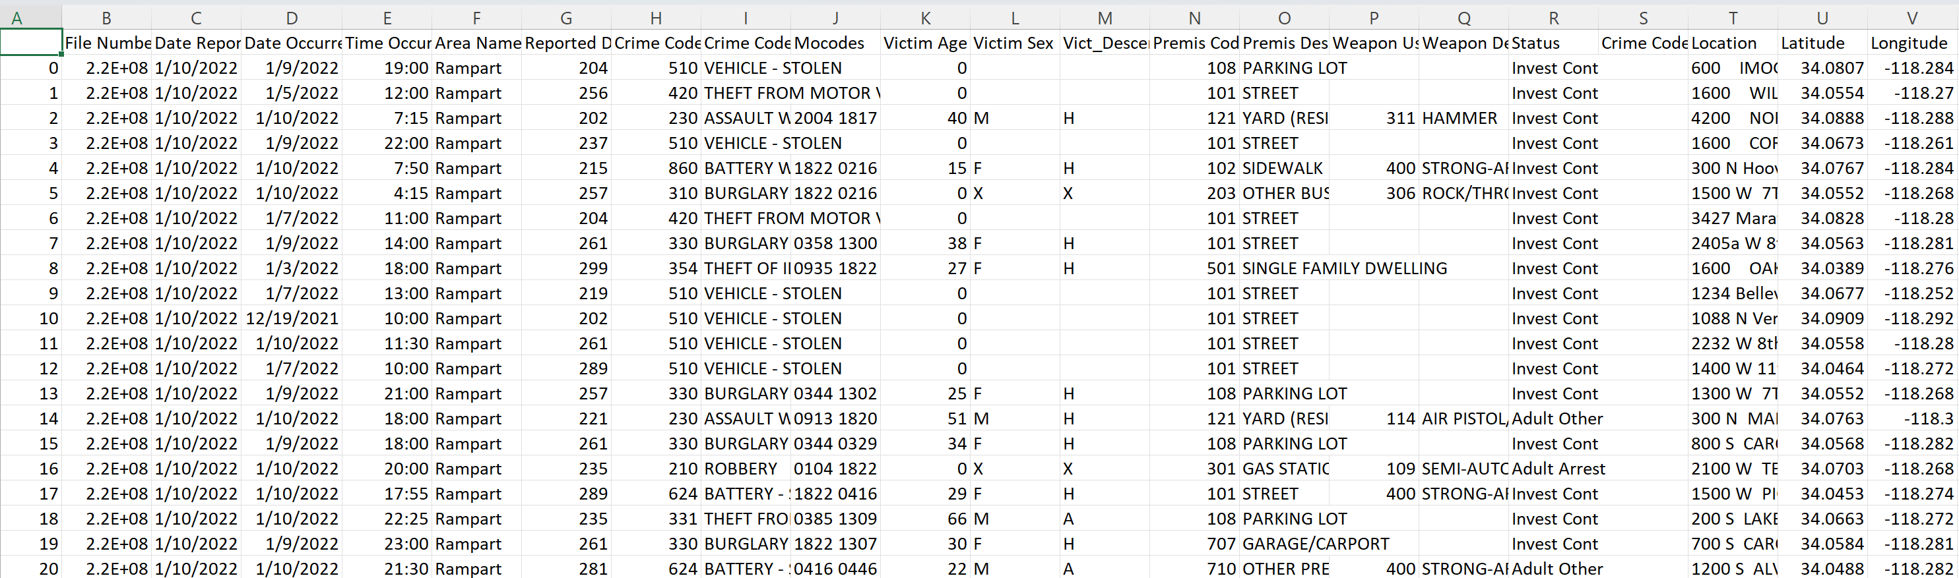
Result Dataset:
Our final dataset contains 21 columns and 416182 rows.

Slide 15
Reference:
Crime Data from 2020 to Present | Los Angeles - Open Data Portal (lacity.org)

Slide 16


